Slide 1
Python Project on "Stock market prediction Using Python Libraries“ Presented By Ayan Adhikary Deepak Kumar Singh

Slide 2
Introduction
In today's competitive business landscape, data analysis plays a crucial role in driving decision-making processes. Creating a analysis of stock markets data, and making prediction for the future, and more. Python, with its powerful libraries for data manipulation and visualization, offers an excellent platform for conducting such analysis efficiently.
This report outlines a Python project focused on analyzing Stock market data using various Python libraries. The project aims to demonstrate the capabilities of Python in handling, processing, and visualizing and making a prediction to derive meaningful insights and for traders.
Overview:
Predicting stock market movements is a challenging task due to its inherent complexity and numerous influencing factors. However, Python provides a variety of tools and libraries that can be utilized for stock market prediction.

Slide 3
Implementation
Data Collection
Data Preprocessing
Libraries for model

Slide 4
Correlation Analysis
Correlation analysis helps in identifying the strength and direction of relationships between different variables, such as stock prices, trading volumes, economic indicators, etc. Understanding correlation helps to uncovering patterns and trends that may influence stock prices.

Slide 5
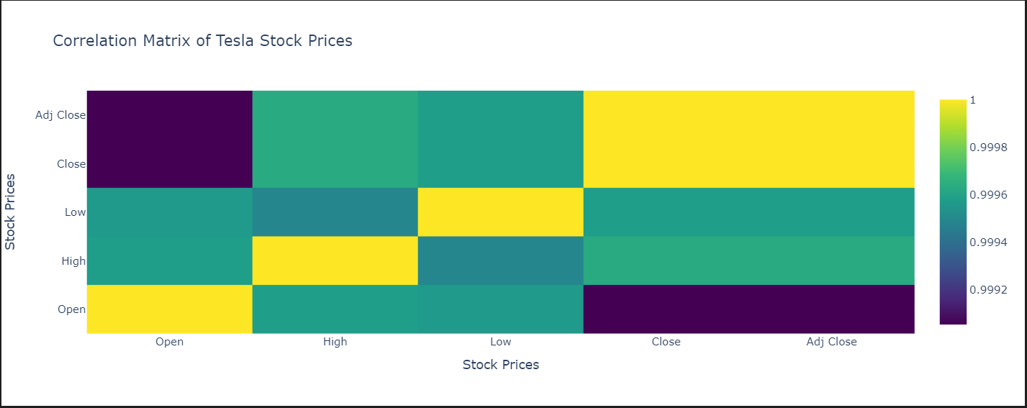
Correlation Analysis

Slide 6
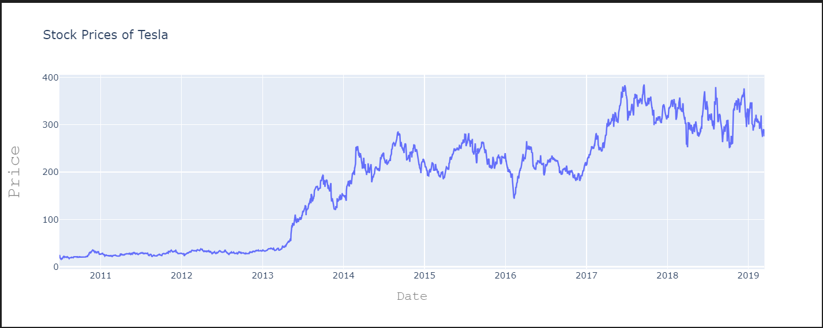
Analysing the price
By analyzing historical stock prices, investors can identify trends in the market, such as whether the market is bullish (prices increasing) or bearish (prices decreasing). Understanding these trends helps investors make informed decisions about when to buy or sell stocks.

Slide 7
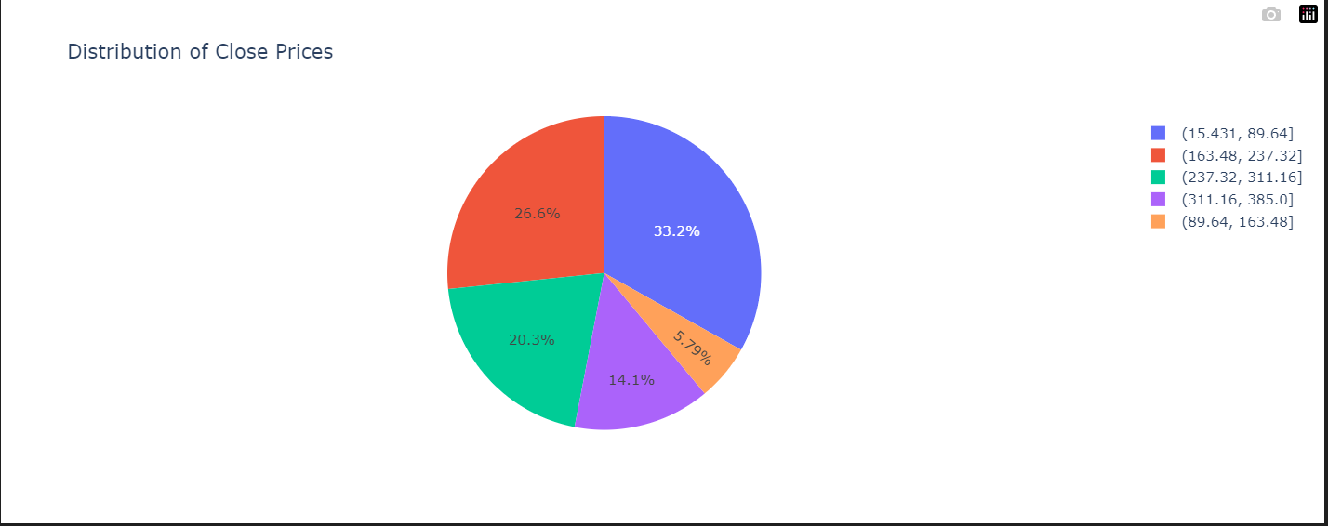
Distribution Of Close price
The distribution of closing prices over time helps in identifying trends in the stock's performance.

Slide 8
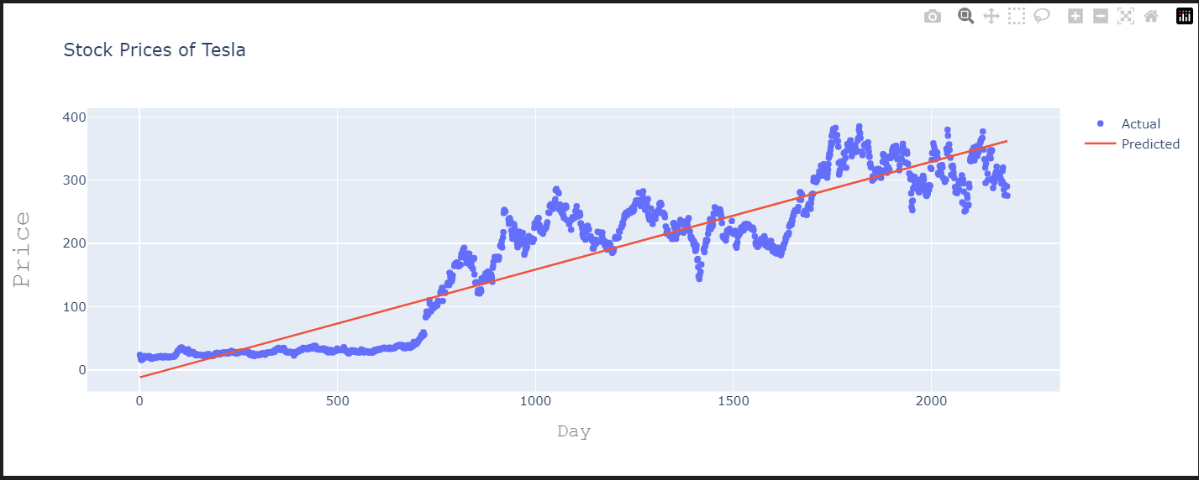
Predicted price using Linear Regression
Regression models can help identify and quantify patterns and relationships in historical stock price data. This allows analysts to understand how various factors contribute to stock price movements. By fitting a regression model to historical data, you can generate predictions for future stock prices. While these predictions are not guaranteed to be accurate, they provide valuable insights for investors and traders in making informed decisions.

Slide 9
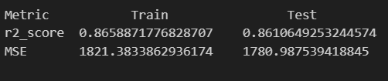
Role of R2 and MSE
R2 indicates the proportion of the variance in the dependent variable that is predictable from the independent variable(s) in a regression model.
Mean Squared Error measures the average squared difference between the actual stock prices and the predicted values.

Slide 10
Conclusion and Future Directions
The project demonstrates the effectiveness of Python libraries for Stock Market Prediction. By leveraging the capabilities of Pandas, Matplotlib, and Sklearn, valuable insights can be derived to support strategic decision-making in Stock market.
Future Direction for the project may include:
Feature Engineering: Incorporating additional features such as trading volume, news sentiment, and technical indicators might improve prediction accuracy.
Advanced Models: Exploring more sophisticated machine learning algorithms such as time-series models, neural networks, or ensemble methods could potentially enhance predictive performance.
Real-time Prediction: Implementing real-time prediction pipelines to continuously update the model with new data and adjust predictions accordingly.

